Slide 1

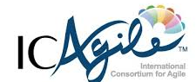
Kubernetes Installation and Architecture
Agile Brains Consulting
‹#›
©Agile Brains Consulting Inc. All rights reserved. Not to be reproduced without prior written consent.

Slide 2
Table of Content
Advantages and Need of an Orchestration Tool
Kubernetes Architecture
Master node components and role
Worker node components and role
Installation of kubeadm in a single node cluster
Kubectl
Managing multiple Kubernetes cluster
Cloud Controller Manager

Slide 3
Containers
Containers are becoming the standard unit of deployment
Each container image has
Code
Binaries
Configuration
Libraries
Frameworks
Runtime
Developers and Operators love containers
Agile Brains Consulting
‹#›
©Agile Brains Consulting Inc. All rights reserved. Not to be reproduced without prior written consent.
Notes:
Docker is developer centric technology
Immutable artifact for your application – that can easily be replicated and recreated in many different environments and platforms that has a Linux host. In order to share your application across many machines and development environments.
Each container image has all the things listed and have complete portability across machines and environments that contains docker engine

Slide 4
Containers
Docker has solved the problem of packaging, deploying and running containerized applications
Docker is great for managing a few containers running on a fewer machines
Production applications deal with dozens of containers running on hundreds of machines
Agile Brains Consulting
‹#›
©Agile Brains Consulting Inc. All rights reserved. Not to be reproduced without prior written consent.
Notes:
Docker is great for running few containers or a collection and is built around abstraction on single machine.
When you move to production – you start dealing with distributed system challenges that require much more sophisticated tooling

Slide 5
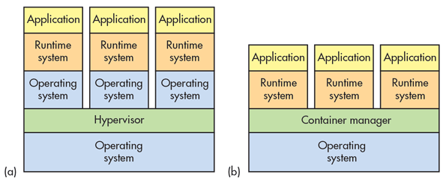
Container Advantages
Portable
Isolated
Lighter footprint & overhead (vs VMs)
Simplify DevOps practices
Speed up Continuous Integration
Empower Microservice architectures and adoption
Agile Brains Consulting
‹#›
©Agile Brains Consulting Inc. All rights reserved. Not to be reproduced without prior written consent.

Slide 6
2.1 Why need container orchestration
Agile Brains Consulting
‹#›
©Agile Brains Consulting Inc. All rights reserved. Not to be reproduced without prior written consent.

Slide 7
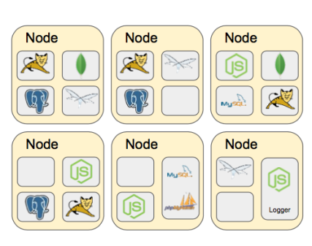
Challenges with multiple containers
How to scale?
Once I scale, where are they?
How do my containers find each other?
How should I manage port conflicts?
What if a host fails?
How to update them? Health checks?
How will I track their logs?
Agile Brains Consulting
‹#›
©Agile Brains Consulting Inc. All rights reserved. Not to be reproduced without prior written consent.

Slide 8
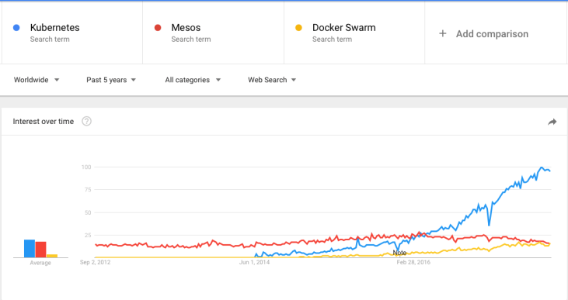
Container Orchestration Tools
The three most popular are: Kubernetes, Docker Swam & Mesos
Kubernetes has become the unofficial standard
Agile Brains Consulting
‹#›
©Agile Brains Consulting Inc. All rights reserved. Not to be reproduced without prior written consent.
Notes:
Google started creation of its own open source orchestration tool ‘Kubernetes’. It has slowly gained dominance as the standard container orchestration tool except for niche use cases.
Mesos
Still used in early container adoption shops and big data applications
Docker Swarm
Lightweight and may be useful for rapid prototyping. With the ease of deploying Kubernetes to public cloud and greater feature set of Kubernetes this use case is increasingly shrinking.

Slide 9
What is Kubernetes?
Kubernetes is inspired from an internal Google project called Borg
Open source container orchestration project managed by the Linux Foundation
Unified API for deploying web applications, batch jobs, and databases
Decouples applications from machines through containers
Declarative approach to deploying applications
Automates application configuration through service discovery
Maintains and tracks the global view of the cluster
APIs for deployment workflows
Rolling updates, Autoscaling
Agile Brains Consulting
‹#›
©Agile Brains Consulting Inc. All rights reserved. Not to be reproduced without prior written consent.

Slide 10
Kubernetes Architecture (Bird’s eye view)
Yaml/Json
config file
Kubernetes Master
API
Node 1
Node 2
UI
Node 3
CLI
Node n
Registry
Agile Brains Consulting
‹#›
©Agile Brains Consulting Inc. All rights reserved. Not to be reproduced without prior written consent.

Slide 11
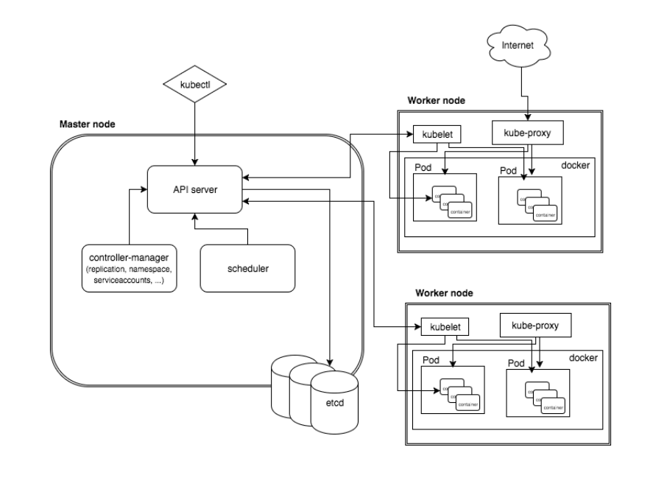
K8s Architecture – detailed
Agile Brains Consulting
‹#›
©Agile Brains Consulting Inc. All rights reserved. Not to be reproduced without prior written consent.

Slide 12
Install Kubernetes on AWS using KubeAdm
Agile Brains Consulting
‹#›
©Agile Brains Consulting Inc. All rights reserved. Not to be reproduced without prior written consent.

Slide 13
Lab: Single node cluster installation using KubeAdm
** Master node need to have at least 2 CPUs
https://github.com/shekhar2010us/kubernetes_teach_git/blob/master/kubernetes_single_node_cluster_installation.md
** Do this lab the first thing – so that we all have machines with Docker which will be used to run exercises in lab 1
** Instructions for installing multi-node k8s cluster is provided in the above link
Agile Brains Consulting
‹#›
©Agile Brains Consulting Inc. All rights reserved. Not to be reproduced without prior written consent.

Slide 14
Kubectl
Agile Brains Consulting
‹#›
©Agile Brains Consulting Inc. All rights reserved. Not to be reproduced without prior written consent.

Slide 15
Kubectl
kubectl is Kubernetes command-line tool for running commands against Kubernetes clusters.
It can be used to deploy and manage applications on Kubernetes.
Using kubectl, you can inspect cluster resources; create, delete, and update components; look at your new cluster; and bring up example apps etc.
Kubernetes Java client
https://github.com/kubernetes-client/java#installation
Agile Brains Consulting
‹#›
©Agile Brains Consulting Inc. All rights reserved. Not to be reproduced without prior written consent.

Slide 16
Kubectl – Installation
https://kubernetes.io/docs/tasks/tools/install-kubectl/
On Ubuntu/Debian
sudo apt-get update && sudo apt-get install -y apt-transport-https
curl -s https://packages.cloud.google.com/apt/doc/apt-key.gpg | sudo apt-key add -
echo "deb https://apt.kubernetes.io/ kubernetes-xenial main" | sudo tee -a /etc/apt/sources.list.d/kubernetes.list
sudo apt-get update
sudo apt-get install -y kubectl
To check installation (execute):
kubectl version
** Note: We have already done it while K8s installation
Agile Brains Consulting
‹#›
©Agile Brains Consulting Inc. All rights reserved. Not to be reproduced without prior written consent.

Slide 17
Kubernetes: Any Node
Any kubernetes node contains:
Addresses
Hostname
External IP
Internal IP
Condition - describe condition of nodes – OutOfDisk, Ready, MemoryPressure, DiskPressure, NetworkUnavailable
Capacity - describe the resources available on the nods – CPU, memory, maximum number of pods that can be scheduled onto the node
Info – general information about the node – kernel version, Kubernetes version, kubelet and kube-proxy version, Docker version, OS name
Command to get node details:
kubectl describe nodes <node_name>
Agile Brains Consulting
‹#›
©Agile Brains Consulting Inc. All rights reserved. Not to be reproduced without prior written consent.

Slide 18
Master Node
Agile Brains Consulting
‹#›
©Agile Brains Consulting Inc. All rights reserved. Not to be reproduced without prior written consent.

Slide 19
Master Node Role
Master components make global decisions about the cluster (for example, scheduling), and detecting and responding to cluster events (starting up a new pod when a replication controller’s ‘replicas’ field is unsatisfied).
Master components can be run on any machine in the cluster. However, for simplicity, set up scripts typically start all master components on the same machine, and do not run user containers on this machine.
Agile Brains Consulting
‹#›
©Agile Brains Consulting Inc. All rights reserved. Not to be reproduced without prior written consent.

Slide 20
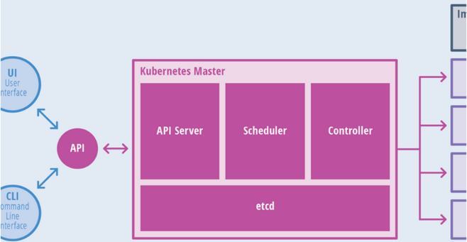
Master Node Components
Components of master:
API Server
Scheduler
Controller
etcd
Agile Brains Consulting
‹#›
©Agile Brains Consulting Inc. All rights reserved. Not to be reproduced without prior written consent.

Slide 21
Master Node Components
The API server is the entry points for all the REST commands used to control the cluster. It processes REST requests, validates them, and executes the bound business logic. The result state has to be persisted in the “etcd” component.
Etcd is an open source, distributed key-value database; it acts as a single source of truth (SSOT) for all components of the Kubernetes cluster. Masters query etcd to retrieve various parameters of the state of the nodes, pods and containers. Etcd is considered a metadata service in Kubernetes.
Agile Brains Consulting
‹#›
©Agile Brains Consulting Inc. All rights reserved. Not to be reproduced without prior written consent.

Slide 22
Master Node Components
Controller Manager is responsible for most of the collectors that regulate the state of the cluster. In general, a controller can be considered a daemon that runs in nonterminating loop and is responsible for collecting and sending information to the API server. It works toward getting the shared state of cluster and then making changes to bring the current status of the server to the desired state. The key controllers are replication controller, namespace controller, and service account controller. The controller manager runs different kind of controllers to handle nodes, endpoints, etc.
Scheduler is one of the key components of Kubernetes master. It is responsible for distributing the workload, tracking resource utilization on cluster nodes and selecting the nodes for the workloads to run. In other words, this is the mechanism responsible for allocating pods to available nodes.
Agile Brains Consulting
‹#›
©Agile Brains Consulting Inc. All rights reserved. Not to be reproduced without prior written consent.

Slide 23
Worker Node
Agile Brains Consulting
‹#›
©Agile Brains Consulting Inc. All rights reserved. Not to be reproduced without prior written consent.

Slide 24
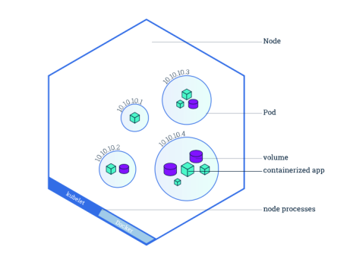
Worker Node Roles
A node is a worker machine in Kubernetes. A node may be a VM or physical machine, depending on the cluster. Each node has the services necessary to run pods and is managed by the master components. The services on a node include Docker, kubelet and kube-proxy.
Allows Pods to be scheduled. A basic worker physical or virtual machine of Kubernetes.
Must be managed by a master
May host multiple pods
Internal IP Address endpoint
Can be tagged and filtered using labels
Agile Brains Consulting
‹#›
©Agile Brains Consulting Inc. All rights reserved. Not to be reproduced without prior written consent.

Slide 25
Worker Node Components
kubelet Service interacts with etcd store to read configuration details and to write values via api-server. It communicates with the master component to receive commands and work. The kubelet process then assumes responsibility for maintaining the state of work and the node server. It manages network rules, port forwarding, etc.
kubelet takes a set of PodSpecs that are provided through various mechanisms and ensures that the containers described in those PodSpecs are running and healthy. The kubelet doesn’t manage containers which were not created by Kubernetes.
Agile Brains Consulting
‹#›
©Agile Brains Consulting Inc. All rights reserved. Not to be reproduced without prior written consent.

Slide 26
Worker Node Components
kube-proxy enables the Kubernetes service abstraction by maintaining network rules on the host and performing connection forwarding.
Kubernetes Proxy Service is a proxy service which runs on each node and helps in making services available to the external host. It helps in forwarding the request to correct containers and is capable of performing primitive load balancing. It makes sure that the networking environment is predictable and accessible and at the same time it is isolated as well. It manages pods on node, volumes, secrets, creating new containers’ health checkup, etc.
Agile Brains Consulting
‹#›
©Agile Brains Consulting Inc. All rights reserved. Not to be reproduced without prior written consent.

